Slide 1
Food Delivery Service Management System
Project Presentation
By Team Renegades (Team 1)
Notes:
Good Evening Sir, Today we will be sharing some details about our project, Food Delivery Service Management System, and discuss some of the salient features and challenges we faced, and if the time permits we will try to show a small demo of our application.

Slide 2
TABLE OF CONTENTS
01
04
About the Project
Challenges Faced
02
05
Approach
Challenging Use Cases
03
06
Salient Feature
Demo
07
Future Scope
Defining the Project, and Describing its Importance
A short note on the challenges faced, and the reason of the decisions we made for the project.
How we approached the problem, and solved the problem
Some of the features that were difficult to implement, and visualize in the beginning.
Discussing some of the features of the project design and requirements
We will show a short demo of the working of our projects.
A vision of what can be added to the project with more knowledge and practice.
Notes:
This is the basic overview of our presentation.

Slide 3
OUR TEAM
Renegades
We are a bunch of hardworking individuals who envision to solve complex problems with simple solutions. Here we tend to solve the problem of food delivery system, which is unavailable in many areas, this system can be implemented in different region, independent of the other places.
Notes:
We are a bunch of hardworking individuals who envision to solve complex problems with simple solutions. Here we tend to solve the problem of food delivery system, which is unavailable in many areas, this system can be implemented in different region, independent of the other places.

Slide 4
ABOUT THE PROJECT
We envision to provide a platform for food delivery service to the people, a platform for restaurants to provide their services online and a place for delivery agents to work. Our platform will provides functionality of modern day food delivery services on a small scale(though scalable).
Notes:
We envision to provide a platform for a food delivery service and manage it. On our platform, customers can see and order food from the menus created by restaurants, then see the updates of the order that was placed. The restaurants can independently create a menu, see the orders that they have received and then update the status of the order. Providing a time for such services is an important part, so we give the restaurants and the delivery agents functionality to give estimated time for food preparation and delivery time. Feedbacks can also be provided by the customer to the restaurant and the delivery agent after the order is completed. The delivery agent can also give rating of the customer.

Slide 5
WHAT WE ARE WORKING ON
SECURE
ACCESSIBLE
FAST AND RELIABLE
We try to make the webapp secure from user data leak, and untrustable use by proper validation of pages.
Usability for all the age groups, easy understanding of the features, and using it for maximum benefit, and easy services.
The processing required should be minimal and the usability should be maximum. Easy implementation of complex features.
Notes:
What We are Working on
We try to build a secure, accessible and a fast and a reliable webApp
Security
We ensure it using proper page validation and hence preventing false use and user data leak.
Accessibility
It can be used by all age groups and has easy to understand features
Fast and Reliable
Speed and reliability is ensured by easy implementation of features and fast computability.

Slide 6
APPROACH
2
Design
1
Requirements
3
Development
6
Review
Agile
We aim to achieve Agility using Scrum Development Methodology in this project. We approach the project with continual planning, learning, improvement, team collaboration, evolutionary development, and timely completion. Encouraging flexible responses to change. We emphasize on individual and team interactions over processes and tools.
5
Deployment
4
Testing
Notes:
We aim to achieve Agility using Scrum Development Methodology in this project. We approach this project with continual planning, learning, improvement, team collaboration, evolutionary development, and timely completion. Encouraging flexible responses to change. We emphasize on individual and team interactions over processes and tools.

Slide 7
Salient Features
Functionality
USER EXPERIENCE
INFORMATION
The Functionality provided can drive the application to success in initial stages.
Simple and easy-to-use implementation for the best user experience.
The information displayed is apt to get the status of the feature used. The more details features can be used in several cases, for better understanding.
Notes:
With implementation of all the features the use cases of the application increases and can be used by more hands. The services provided can fulfill the needs of the system and future production and upgrade will take it to a whole new user experience.
Talking about user experience, the design is minimal, with easy to understand working. Any user can get used to the app after using it for several time, no special guidance is required.
The information displayed is safe, and can be understand easily. More details can be used to see more information.

Slide 8
Continue...
Extensibility
Storage
The Software can be developed easily, with easy to use function definitions, making addition of new features simple and effortless.
Instead of creating multiple instances of same piece of information, we use unique Ids for every object.
Notes:
Extensibility is one of the highlights of our project, we have code that can be easily extended and reproduced to include more features, and develop in the future.
Storage is one of the main concern in today’s world, so we try to prevent making copies of the same thing and rather making one instance of every object or collection.

Slide 9
Challenges Faced
Expansion
Tech Stack
Integration
Code was made compatible with different platforms and rigorous testing was done before writing new code and implementing new functions.
Our Tech Stack includes Flask, Python, Jinja, HTML, CSS, Javascript and Firebase.
These were some new things for us and took time to get used to.
Working in different parts in order to do more in short period of time, integration took some time.
Notes:
We faced some challenges while making this project. Integration took more time than expected, we worked in different parts in order to do more in less time. Our tech stack includes Flask, Python ,Jinja, HTML, CSS, Javascript and Firebase. Some of these were new things to us, and it took a while to get used to it. Code was made compatible with different platforms and rigorous testing was done before writing new code and implementing new functions.

Slide 10
Why WebApp?
These are the reasons why we implemented our project as a web app.
Easier to implement the GUI
Large coding community, easier to get doubts cleared
No packages handling - easier to update the app
Platform independent - works on any OS.
Better security features
Option for the app to grow worldwide - host somewhere
More options and better features for the database
Notes:
Easier implementation of GUI is one of the major reasons we made our project as a web app. Community of web developers is huge and it was very easy for us to get our doubts cleared using stackoverflow, geeksforgeeks etc. . There is no version handling and package handling in web app, just update the code and push it, it will be live instantly! Also, since it is a web app , it is platform independent, it works on any operating system having a web browser and an internet connection. There were other reasons like security features,database features etc.

Slide 11
Easy to Implement, Flask
These are the reasons why we used flask as a backend
Easier to handle API requests
Easier to implement than Django
Beforehand knowledge of python
Availability of all the required packages in python
Notes:
We used Flask as our backend because handling API requests with is lot more easier and its implementation is simpler than django. All of the required packages for handling session, firebase etc. were available in python , so we didn’t faced any packages issues either. Moreover, we had beforehand knowledge of python, so we could code the backend fastly.

Slide 12
Firebase Integration
These are the reasons why we used firebase as database
Easier user authentication and handling
Easier to implement - NoSQL Database
More security - Firebase by default provides JWTs
Notes:
Firebase is an online NoSQL database. Thus, we didn’t have to implement any classes in it. Firebase also provides JWTs(JSON Web Tokens) which enhances the security and user authentication and creation got easier.

Slide 13
Challenging Use Cases
Session Handling
Status Update
Frontend and Backend Integration
Cookies
We were facing problems in user authentication, so we used JWTs and Flask’s session module to handle it.
With an order reaching different stages, it was difficult to implement on how to update the information, on all the three type of users.
With different people working on front-end and backend, the information passing and design implementation required few updates to accommodate both the teams.
We have to make sure that size of the cookies containing session user meta data don’t become to large.
Notes:
There were many challenging use cases that we had to implement, I am going to share some of them here. Session Handling, we were facing problem in user authentication and preventing users from accessing urls that were not meant for them.
The second challenge we faced, and were almost not able to solve it was cookies, we had to use multiple cookies for storing data.
One of the most important and challenging case was the order updates that were provided by the restaurant and the delivery agent and are seen by the customer. We had to transfer data from restaurant and delivery agents to the customer and at the same time, update the levels( will be shown in the demo) for the order.
The next and the most crucial part is the integration of the front-end and the back end, using firebase, the online database service provided by google, was not easy to understand at first, but came in handy in the later part.

Slide 14
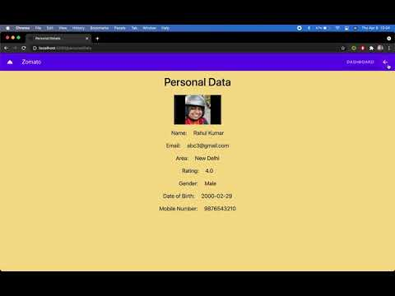
DEMO
Notes:
Now let us take a peek on how our programs looks like and how it functions.

Slide 15
Future Scope
Platform Integration with Google maps
Integration of a payment gateway
Implementation of a DL driven recommendation system in the backend
Ideas
Semi-Automatic updates for restaurants and Delivery Agents
Hosting on Cloud Application Hosting Platform
Automated Offer generation, and Distribution to the Customers
Introducing AI chatbot for easy navigation and usage
Notes:
Our future vision consists of
First, integration of a payment gateway so that our users can directly pay online using debit card, credit card or UPI.
Next, integration with google maps, so that users can precisely mark their location on the map and can also see the location status of the delivery agent.
Next, Recommendation system can be improved by using order metadata to build a DL driven recommendation system in the backend
Next, Hosting on Cloud Application Hosting Platform
Next, build an AI Chatbot, so that the platform can be more interacting and common queries can be answered immediately.
Next, automated Offer generation and Distribution to the customers.
Next, Semi- Automatic updates for restaurants and delivery agents.

Slide 16
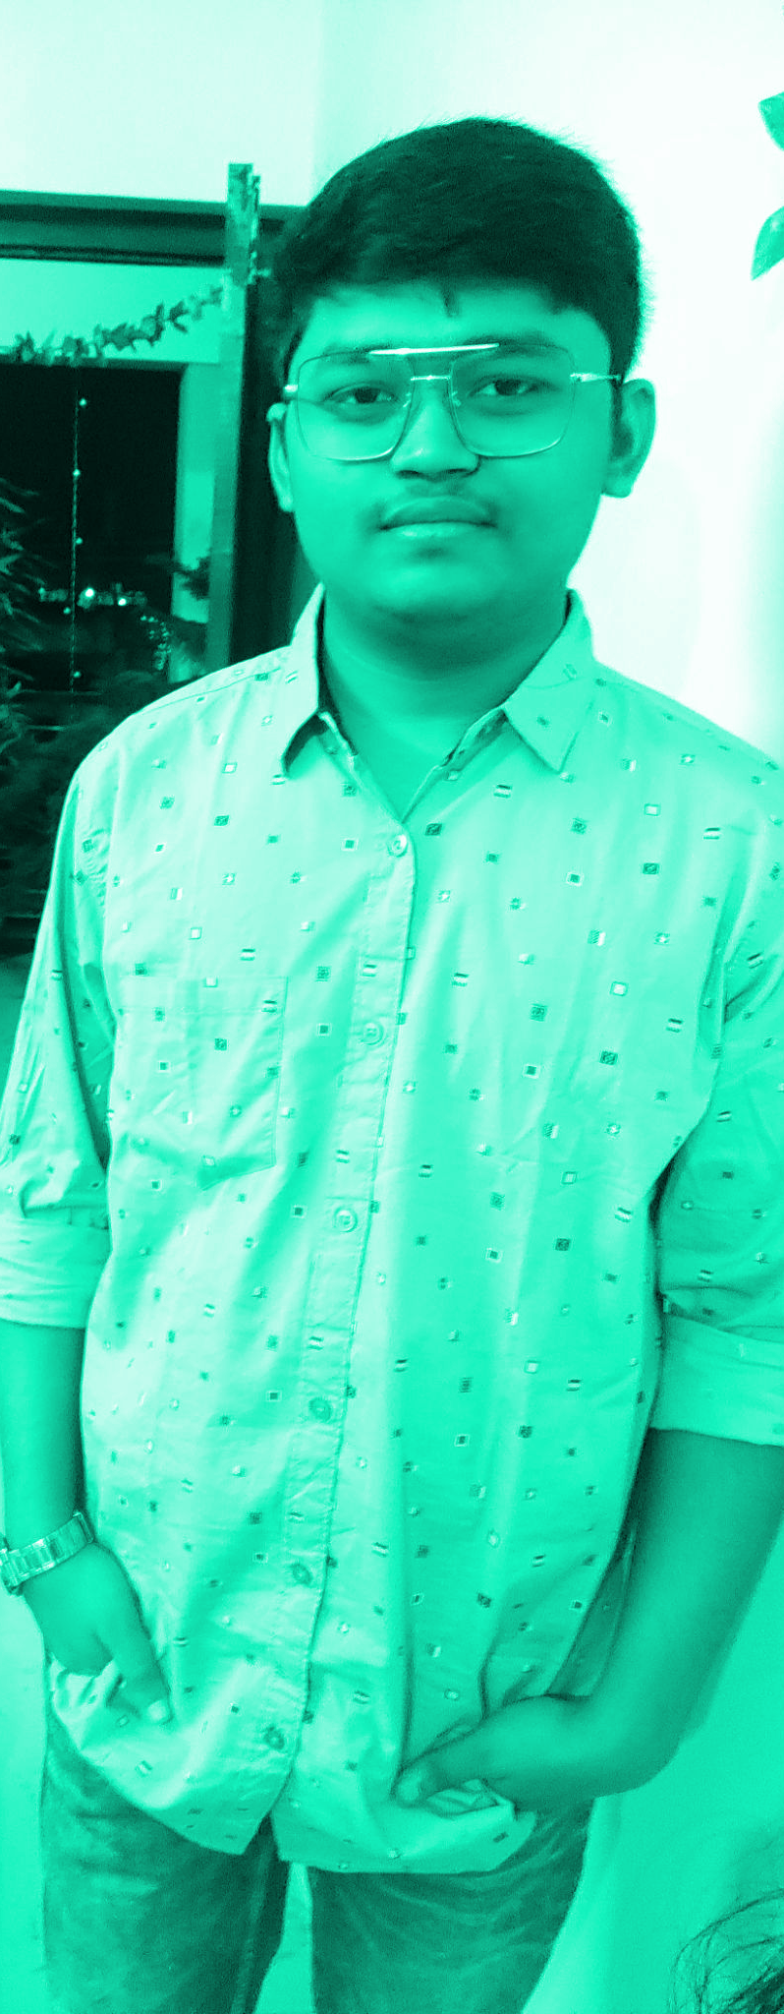

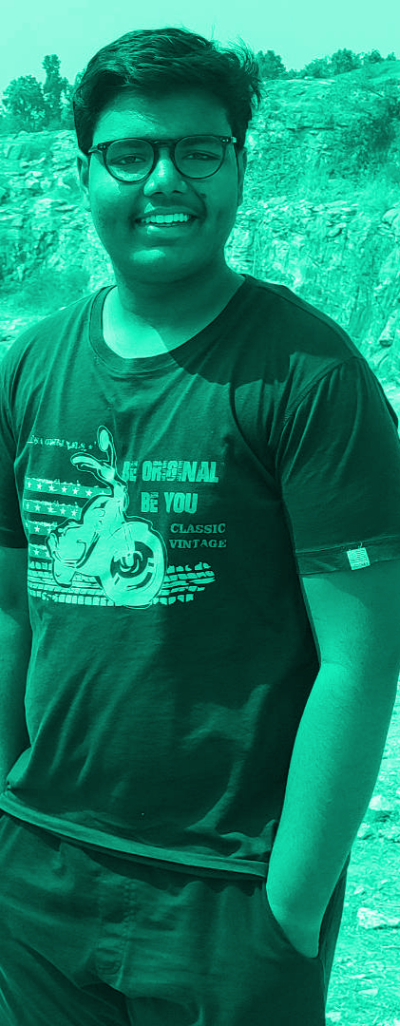
OUR TEAM Team Renegades
Satvik Bansal
Anish Sofat
Aryan Agarwal
19CS10053
19CS10011
19CS30005

Slide 17
THANKS!
Hope you liked our presentation
Do you have any questions?

